Slide 1

DriverPass System Analysis
Tomas Palma Alvarado
Notes:
[No speaker notes required for this slide.]

Slide 2

System Requirements
Functional Requirements
Payment portal system
DMV update information system
Nonfunctional Requirements
Security
Compatibility
Notes:
“Functional and nonfunctional are key tools in developing an application like DriverPass. Functional requirements describe specific features of the application while nonfunctional requirements explain how the system should behave. The functional requirements of a payment portal and DMV update information system were both explicitly requested in the interview with DriverPass. The development of these two requirements will lead to a robust and reliable application. In terms of nonfunctional requirements, security and compatibility are crucial for the creation and successful application. Without security, DriverPass could not hope to keep a consistent user base and would ultimately fail. Compatibility will also expand the reach of the application reaching more potential users.“

Slide 3
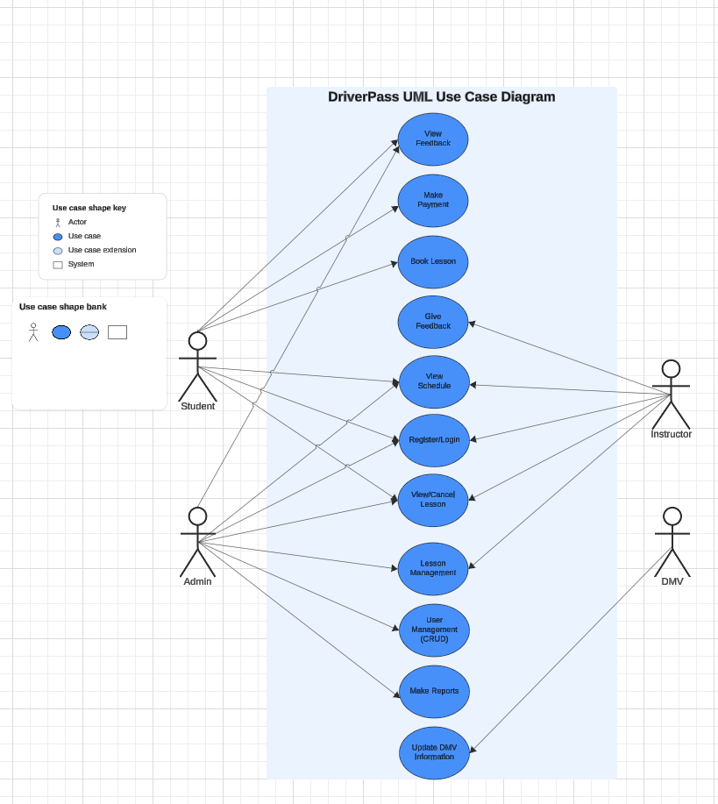
Use Case Diagram
Notes:
“The DriverPass system will interact with students, instructors, admins, and the DMV. Students, instructors, and admins will all be able to create profiles, view schedules, and manage classes, including the ability to view or cancel them. Students will have special functionalities for receiving feedback and making payments. Instructors will focus on providing feedback to the students in their courses. Admins are the only users who can manage user accounts by creating, updating, and deleting profiles on the website. They will also generate and download reports on users, as requested by DriverPass. The DMV plays a crucial role in updating the application with the latest regulations. This system creates an ecosystem where all types of users can operate in harmony, ultimately providing students with a reliable way to receive driving instruction.”

Slide 4
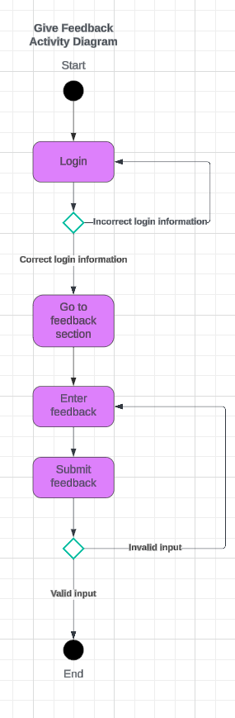
Activity Diagram
Notes:
“One of the main ways students receive training in their driving instruction is through the instructor feedback system, shown here. This diagram illustrates the process, starting from the instructor logging in, to submitting feedback for the students. To complete this task, the instructor must first successfully log in to access the feedback page. Instructors then enter their feedback into a provided box, and if the submission is valid, they will see a confirmation message indicating successful submission. However, if the feedback is invalid—such as being empty or containing inappropriate language—the instructor will see an error message and be directed back to an empty feedback submission page to try again. During discussions with DriverPass, they emphasized the importance of students receiving timely feedback for their courses—this system ensures that this critical need is met effectively.”

Slide 5
Security
User authentication
User authorization
Encryption
Firewall
Notes:
“In today’s world, an insecure application is destined to fail. When designing the DriverPass system, security was a priority from the outset. To begin with, the application will use user authentication, which protects accounts by requiring users to log in with their credentials. We also ensure that each user can only access the parts of the website appropriate for their role—for example, a student will have different access than an admin. Additionally, the website will encrypt sensitive information, making it much harder for attackers to access or misuse this data. Finally, a firewall provided by our cloud services provider will be in place to protect the application from potential threats.”

Slide 6
System Limitations
Scalability
Reliance on outside sources
Technological dependence
Notes:
“The DriverPass application, like most others, has some limitations that need to be recognized and addressed. First is the issue of scalability, which involves the website’s ability to handle a growing number of users. If the application isn’t built correctly, it may not scale well, leading to a reduction in performance. This could cause users to to unsubscribe from DriverPass and find alternative studying routes. Another limitation is the website’s reliance on external sources. The accuracy of the information on DriverPass depends on timely updates from the DMV, so if the DMV fails to provide updates promptly, the site could display outdated or incorrect information. Finally, the application requires an internet connection, which may limit access for some potential users.”

